Slide 1
ONLINE EDUCATION
Presented by- Sara Babu
S2 CSE A
56

Slide 2
Content
Introduction
Spread of online education
Pons
Cons
Some educational websites
Online education and covid
Conclusion

Slide 3
INTRODUCTION
1
2
4
Online education is a flexible instructional delivery system.
It encompasses any kind of learning that takes place via the internert.

Slide 4
It supports students who need to work on their on schedule.
It makes educators to reach students who are not able to attend traditional classroom course.

Slide 5
How online education is spreading?
It started in 1990s: and countries all over the world are welcoming it!

Slide 6



For Everyone
Learn from anywhere
Learn anytime
Anyone who want to learn can learn
An off-campus home, Internet is everywhere
No fixed timing

Slide 7
PROS OF ONLINE EDUCATION
Cost Effective
Efficiency
Flexibility
Self paced learning
New technical skills

Slide 8
4
RESOURCES
CONS OF ONLINE EDUCATION
Slow internet connection
Easier to procrastinate.
Inability to focus on screen
Lab work is difficult
Distractions on social media.

Slide 9

Little or no face to face interaction.
Create a sense of isolation.
It gives you more freedom, perhaps, more than you can handle!
Manage screen time.

Slide 10

Some Educational websites
Coursera
Udemy
Edx
Masterclass
Skillshare

Slide 11
Online learning during COVID-19 pandemic
The COVID-19 has resulted in schools shut all across the world. Globally, over 1.2 billion children are out of the classroom.
As a result, education has changed dramatically, with the distinctive rise of e-learning, whereby teaching is undertaken remotely and on digital platforms.
Research suggests that online learning has been shown to increase retention of information, and take less time, meaning the changes coronavirus have caused might be here to stay.

Slide 12

CONCLUSION
Hence, every system of education has got benefits and drawbacks.
It cannot be told this particular system is best or worst.
According to our convenience and based on suitability of the benefits you can choose the best one and educate yourself well

Slide 13

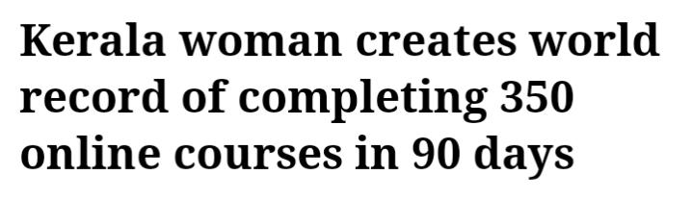

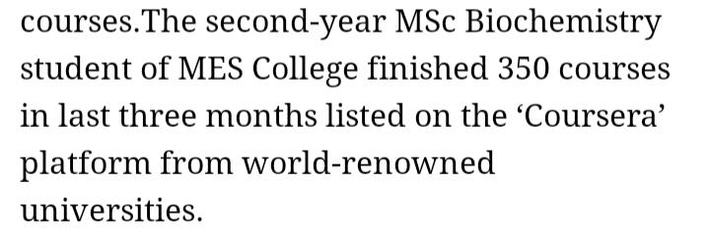

Slide 14
Reference
https://www.encyclopedia.com/finance/finance-and-accounting-magazines/online-education
ONLINE
COURSE
https://www.ies.ncsu.edu/resources/white-papers/pros-and-cons-of-online-education/
LEARN
https://www.weforum.org/agenda/2020/04/coronavirus-education-global-covid19-online-digital-learning/

Slide 15

Thankyou

